Slide 1
Static Equilibrium and Elasticity

Slide 2
Static Equilibrium
Equilibrium implies that the object moves with both constant velocity and constant angular velocity relative to an observer in an inertial reference frame.
Will deal now with the special case in which both of these velocities are equal to zero
  This is called static equilibrium.
Static equilibrium is a common situation in engineering.
The principles involved are of particular interest to civil engineers, architects, and mechanical engineers.

Slide 3
Elasticity
LECTURE GOALS
We will disuses how objects deform under load conditions.
An elastic object returns to its original shape when the deforming forces are removed.
Various elastic constants will be defined, each corresponding to a different type of deformation.

Slide 4
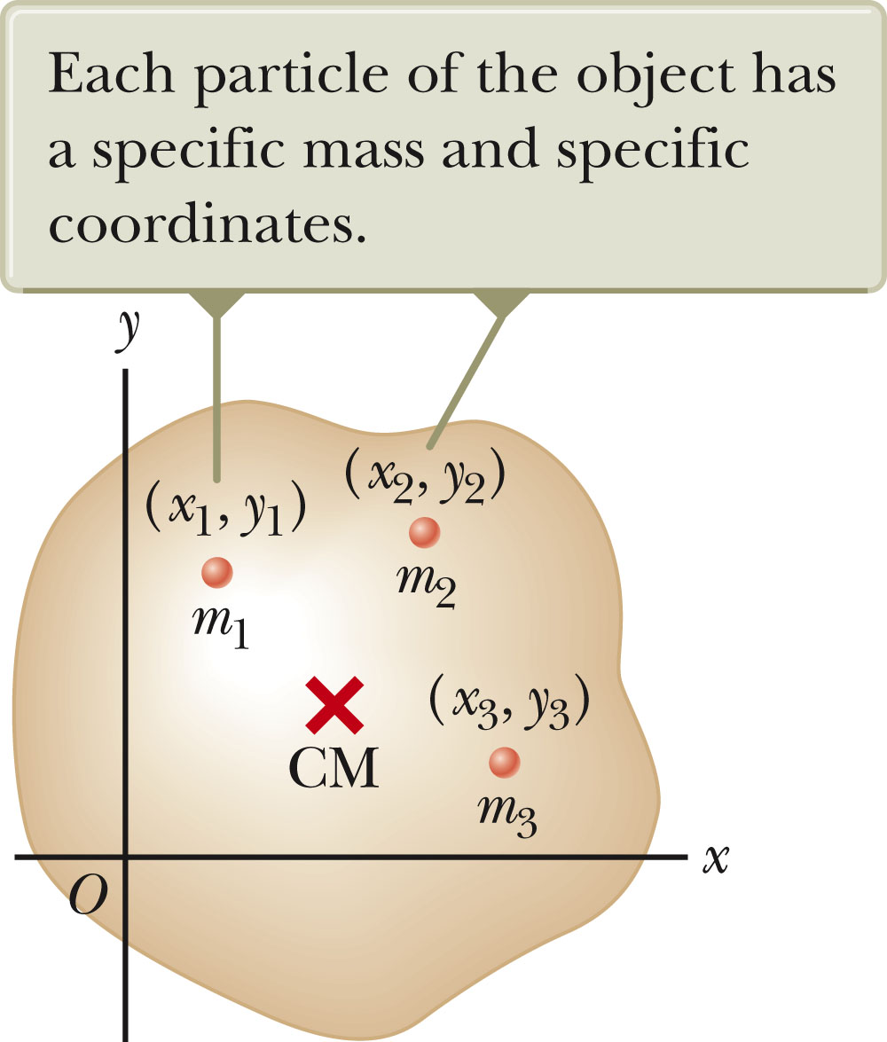
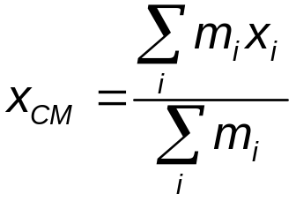
Center of Mass
An object can be divided into many small particles.
  Each particle will have a specific mass and specific coordinates.
The x coordinate of the center of mass will be
Similar expressions can be found for the y and z coordinates.

Slide 5
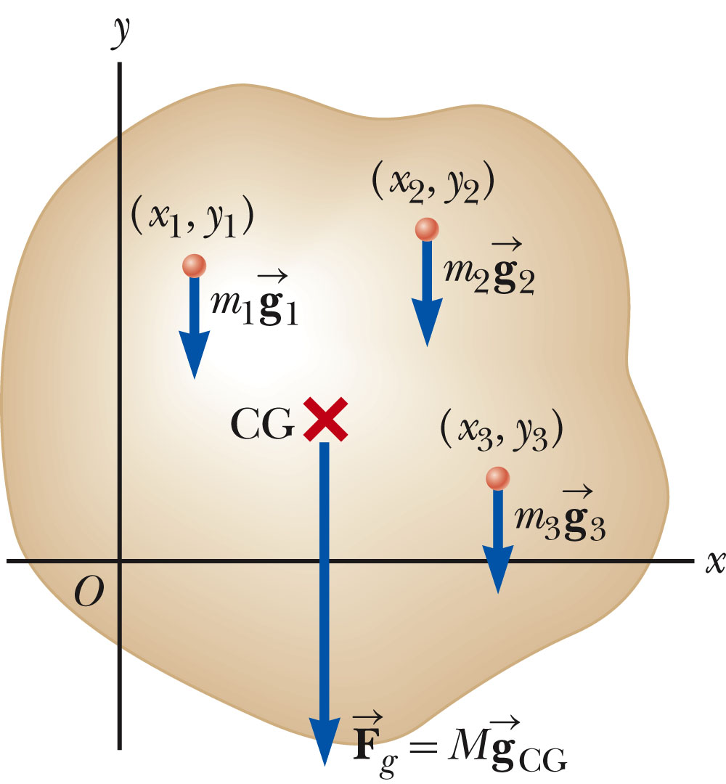
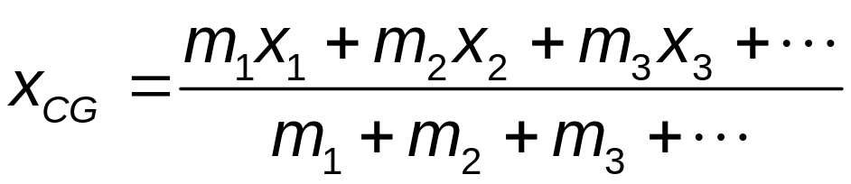
Center of Gravity
All the various gravitational forces acting on all the various mass elements are equivalent to a single gravitational force acting through a single point called the center of gravity (CG).
Each particle contributes a torque about an axis through the origin equal in magnitude to the particle’s weight multiplied by its moment arm.

Slide 6
Center of Gravity, cont
The torque due to the gravitational force on an object of mass M is the force Mg acting at the center of gravity of the object.
If g is uniform over the object, then the center of gravity of the object coincides with its center of mass.
If the object is homogeneous and symmetrical, the center of gravity coincides with its geometric center.

Slide 7
Definitions Associated With Deformation
Stress
  Is proportional to the force causing the deformation
  It is the external force acting on the object per unit cross-sectional area.
Strain
  Is the result of a stress
  Is a measure of the degree of deformation

Slide 8
Elasticity
So far we have assumed that objects remain rigid when external forces act on them.
  Except springs
Actually, all objects are deformable to some extent.
  It is possible to change the size and/or shape of the object by applying external forces.
Internal forces resist the deformation.

Slide 9
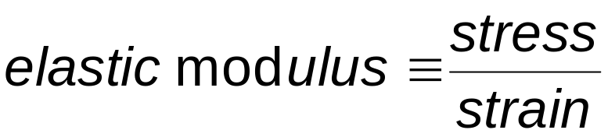
Elastic Modulus
The elastic modulus is the constant of proportionality between the stress and the strain.
  For sufficiently small stresses, the stress is directly proportional to the strain.
  It depends on the material being deformed.
  It also depends on the nature of the deformation.
The elastic modulus, in general, relates what is done to a solid object to how that object responds.
Various types of deformation have unique elastic moduli.

Slide 10
Three Types of Moduli
Young’s Modulus
  Measures the resistance of a solid to a change in its length
Shear Modulus
  Measures the resistance of motion of the planes within a solid parallel to each other
Bulk Modulus
  Measures the resistance of solids or liquids to changes in their volume

Slide 11
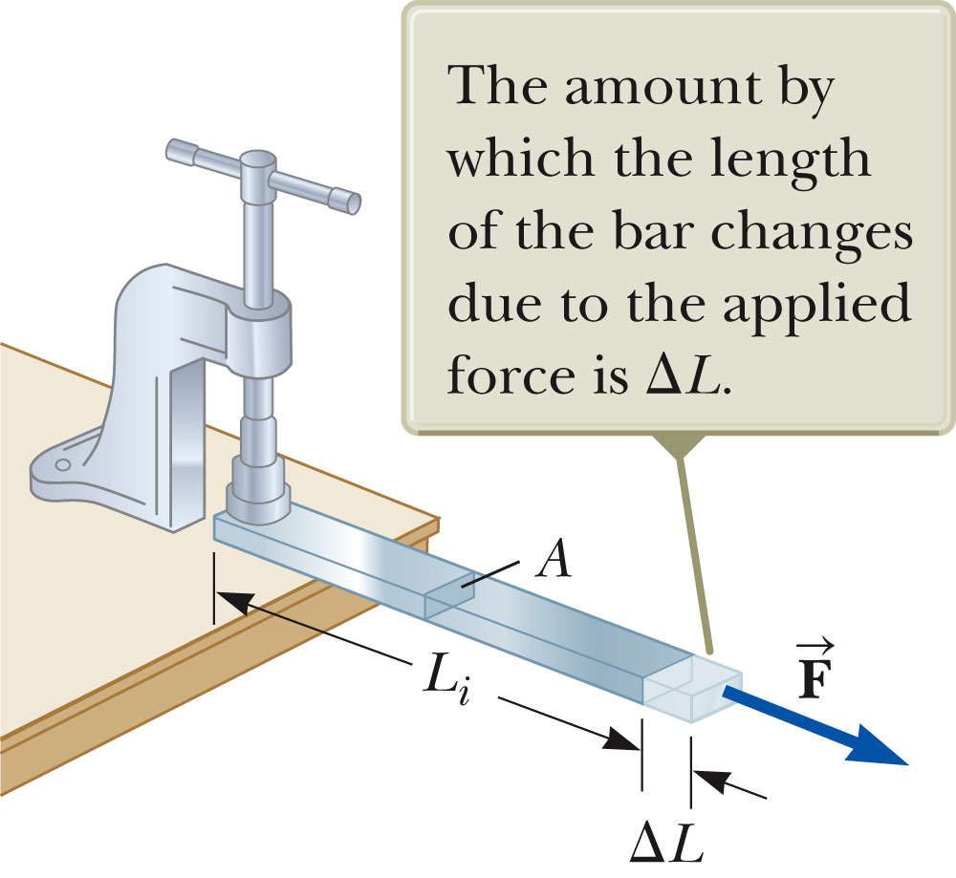
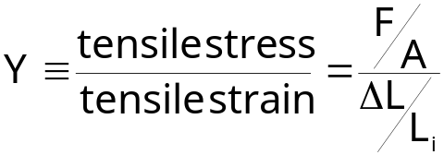
Young’s Modulus
The bar is stretched by an amount ΔL under the action of the force F.
The tensile stress is the ratio of the magnitude of the external force to the cross-sectional area A.
The tension strain is the ratio of the change in length to the original length.
Young’s modulus, Y, is the ratio of those two ratios:
Units are N / m²

Slide 12
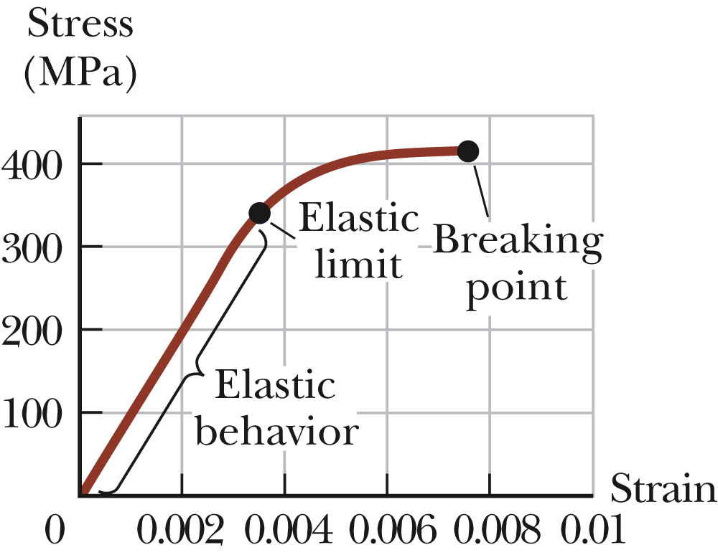
Stress vs. Strain Curve
Experiments show that for certain stresses, the stress is directly proportional to the strain.
This is the elastic behavior part of the curve.
The elastic limit is the maximum stress that can be applied to the substance before it becomes permanently deformed.

Slide 13
Stress vs. Strain Curve, cont’d.
When the stress exceeds the elastic limit, the substance will be permanently deformed.
  The curve is no longer a straight line.
With additional stress, the material ultimately breaks.

Slide 14
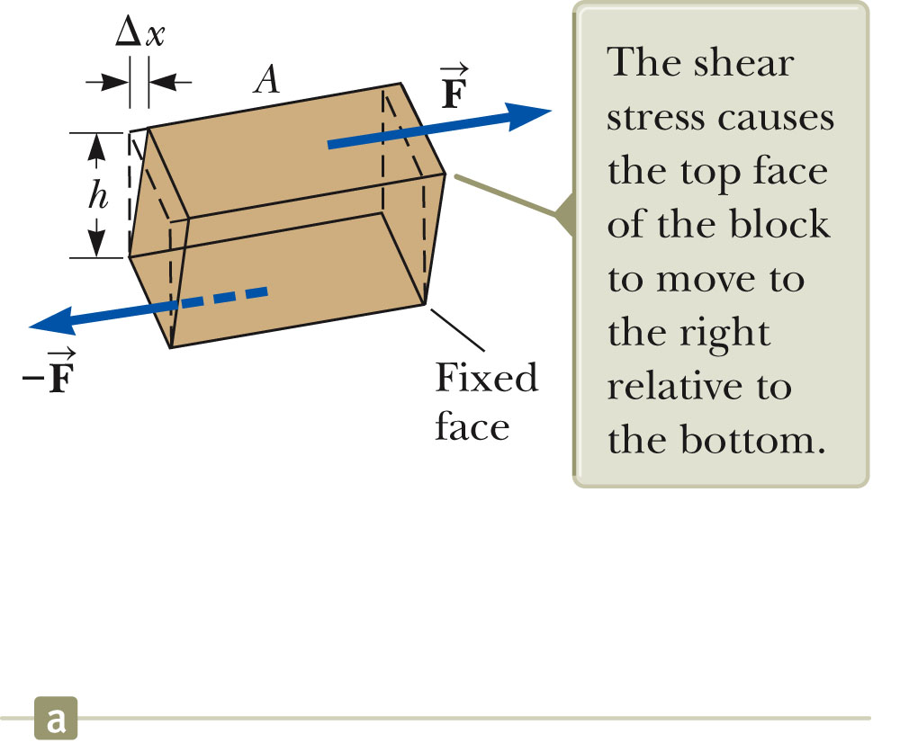
Shear Modulus
Another type of deformation occurs when a force acts parallel to one of its faces while the opposite face is held fixed by another force.
This is called a shear stress.
For small deformations, no change in volume occurs with this deformation.

Slide 15

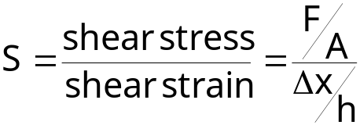
Shear Modulus, cont.
The shear strain is Δx / h.
  Δx is the horizontal distance the sheared face moves.
  h is the height of the object.
The shear stress is F / A.
  F is the tangential force.
  A is the area of the face being sheared.
The shear modulus is the ratio of the shear stress to the shear strain.
Units are N / m²

Slide 16
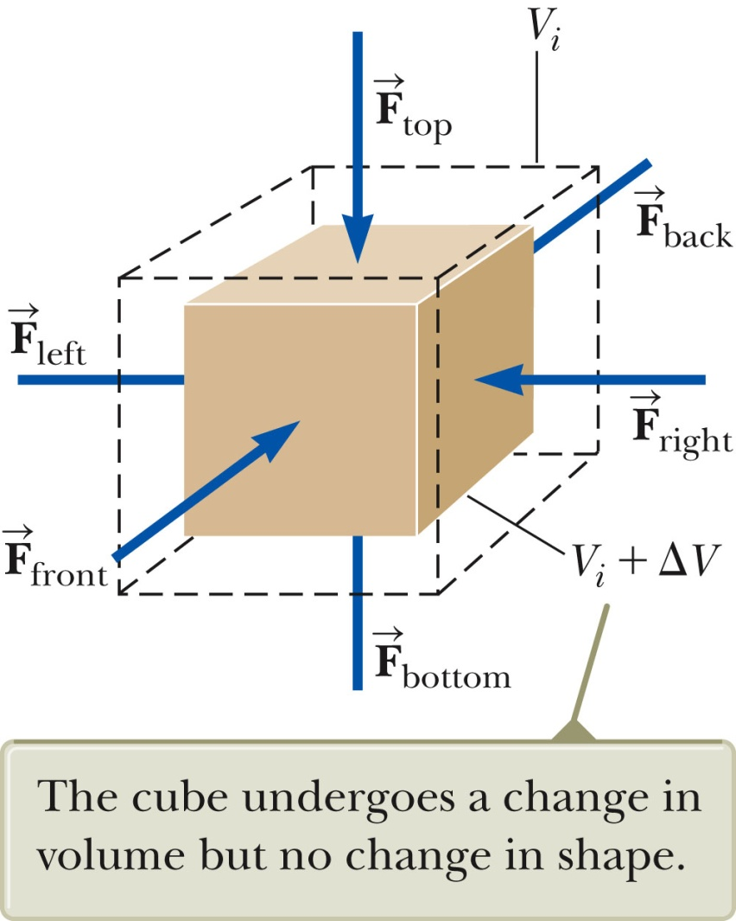
Bulk Modulus
Another type of deformation occurs when a force of uniform magnitude is applied perpendicularly over the entire surface of the object.
The object will undergo a change in volume, but not in shape.
The volume stress is defined as the ratio of the magnitude of the total force, F, exerted on the surface to the area, A, of the surface.
  This is also called the pressure.
The volume strain is the ratio of the change in volume to the original volume.

Slide 17
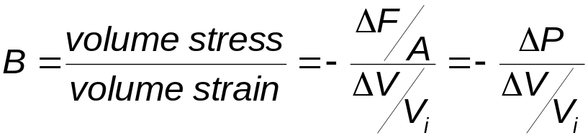
Bulk Modulus, cont.
The bulk modulus is the ratio of the volume stress to the volume strain.
The negative indicates that an increase in pressure will result in a decrease in volume.

Slide 18
Compressibility
The compressibility is the inverse of the bulk modulus.
It may be used instead of the bulk modulus.

Slide 19
Moduli and Types of Materials
Both solids and liquids have a bulk modulus.
Liquids cannot sustain a shearing stress or a tensile stress.
  If a shearing force or a tensile force is applied to a liquid, the liquid will flow in response.

Slide 20
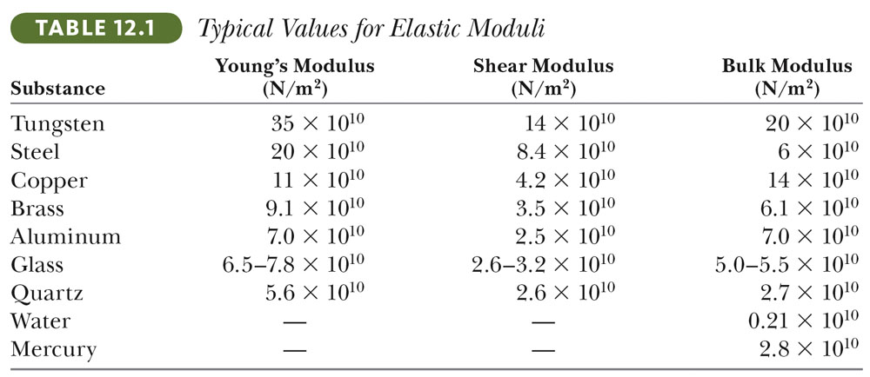
Moduli Values

Slide 21
Problem
A 20-m long steel wire (cross-section 1.0 cm², Young's modulus 2.0 x 10¹¹ N/m²), is subjected to a load of 25 000 N. How much will the wire stretch under the load?
Ans: 2.5 cm

Slide 22
Problem
How large a force is necessary to stretch a 2.0-mm diameter copper wire (Y = 11 x 10¹⁰ N/m²) by 1.0%?
Ans: 3.5 kN

